Slide 1


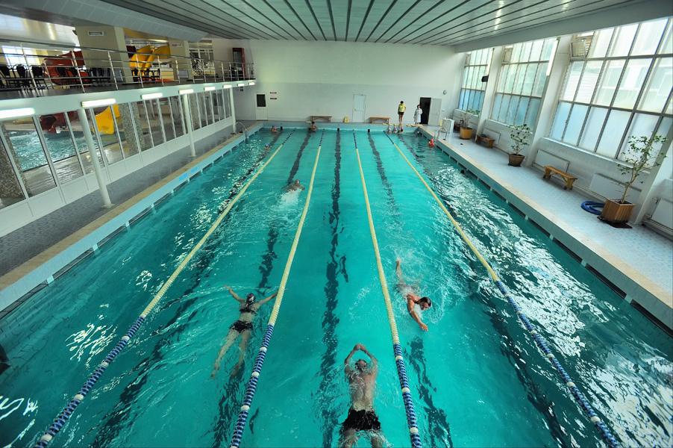
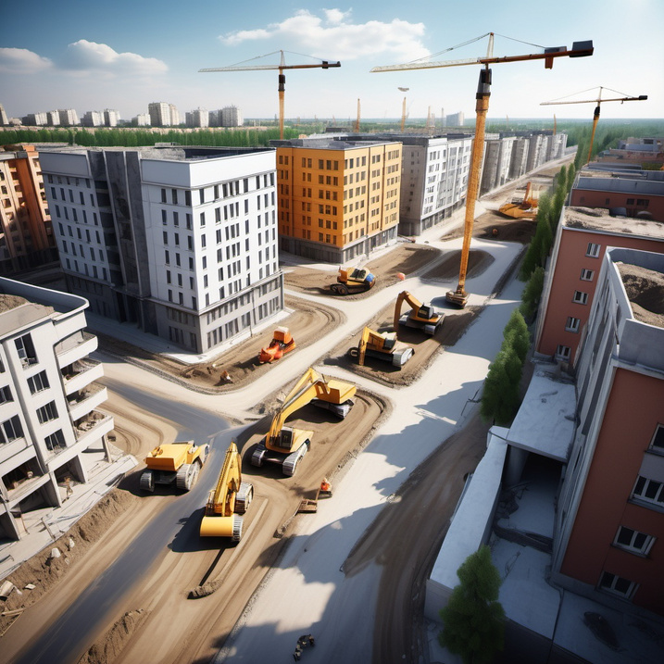
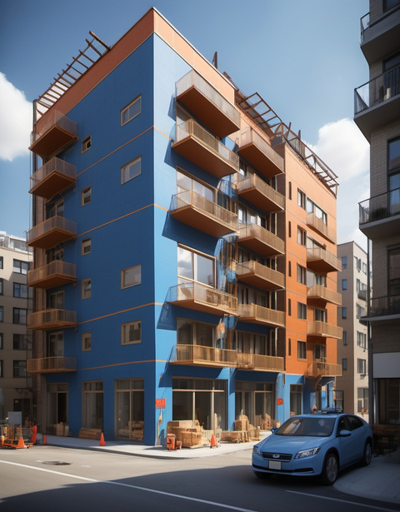

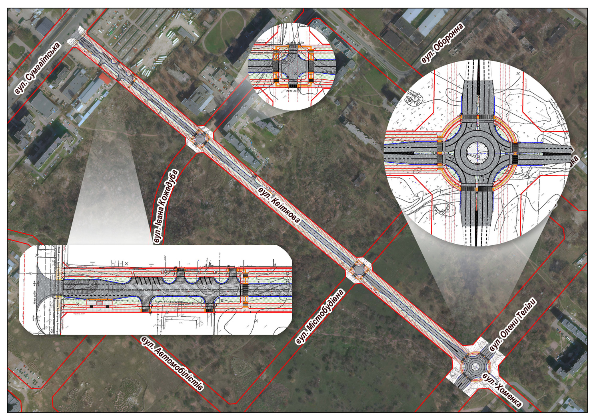


The project "Construction of Kvitkova Street from Sumgaitska st. to Khomenko st., Cherkasy"

Slide 2

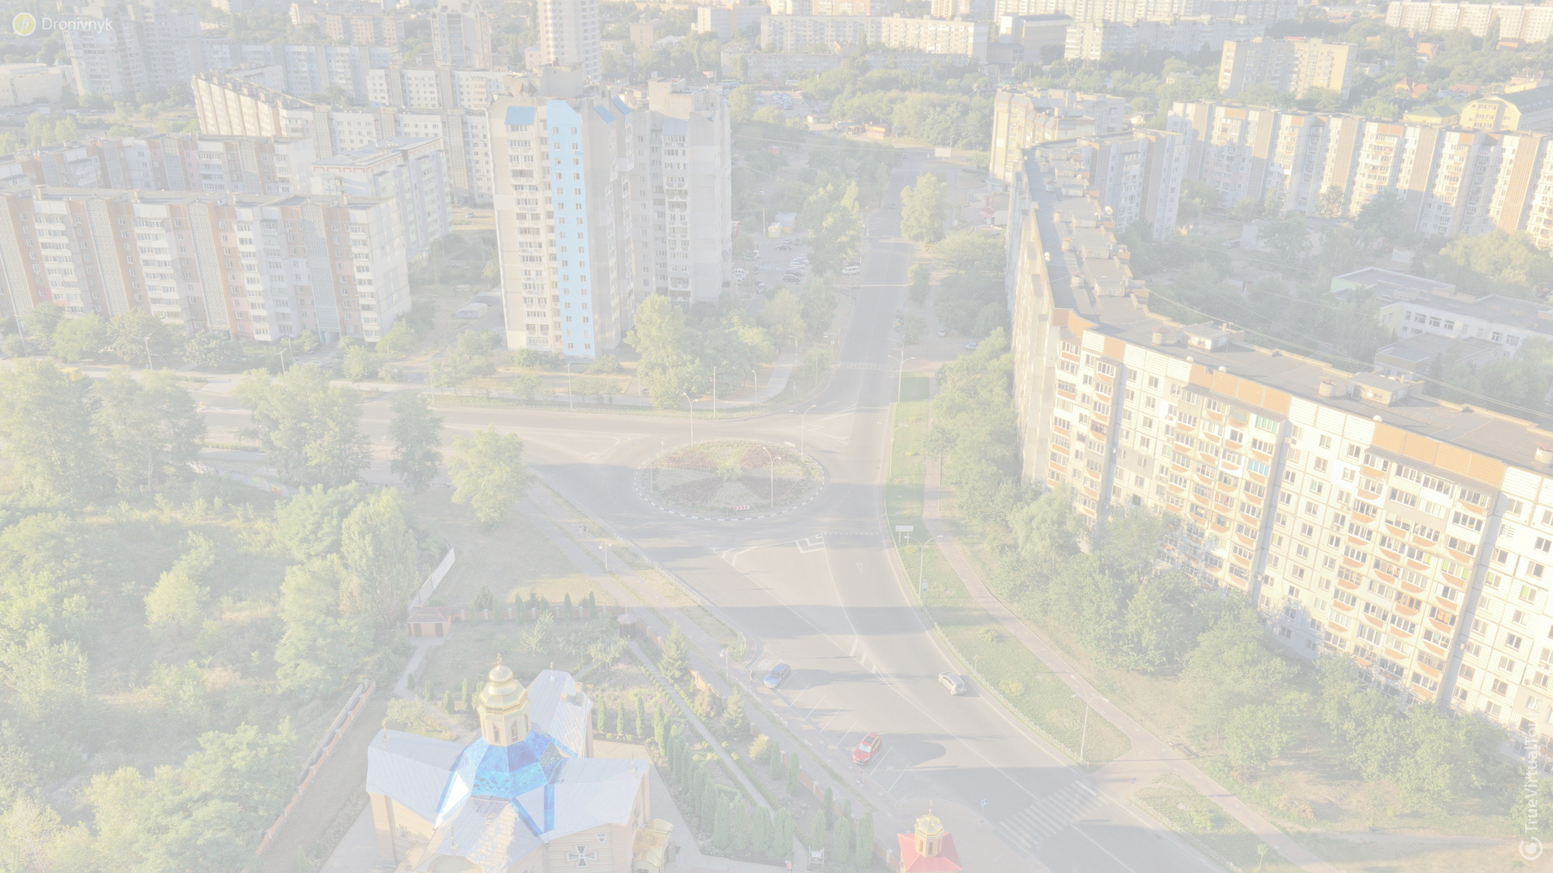






The project "Construction of Kvitkova Street from Sumgaitska st. to Khomenko st., Cherkasy"
arrangement of the road
arrangement of velo tracks
street lighting
landscaping
The total cost of the project is
≈ 4 070 000 EUR

Slide 3
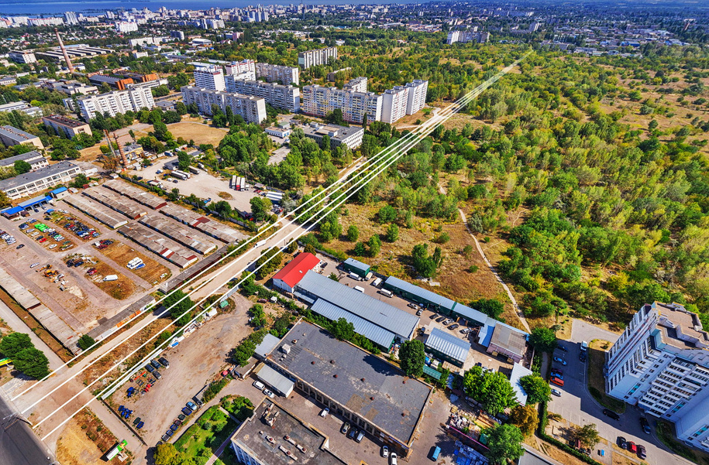

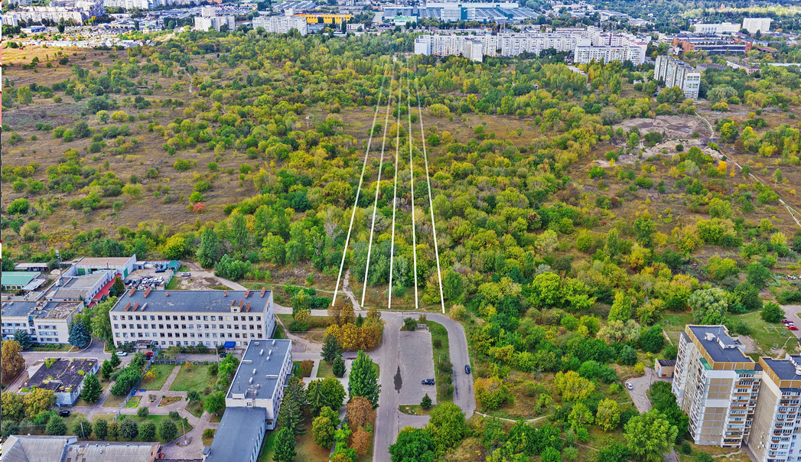

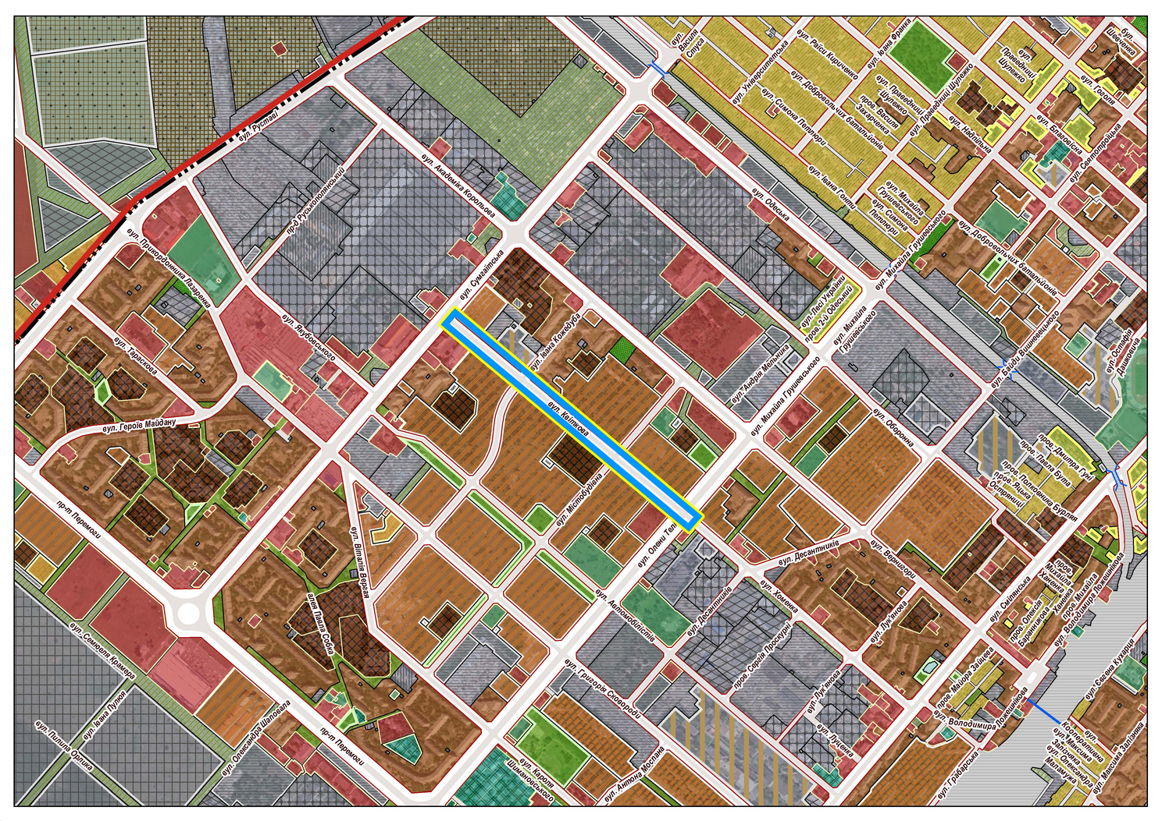


Implementation of the project will provide the city with:
conditions for the development of the microdistrict
expansion of bicycle infrastructure
development of automobile infrastructure
connection of microdistricts

